Slide 1
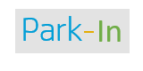
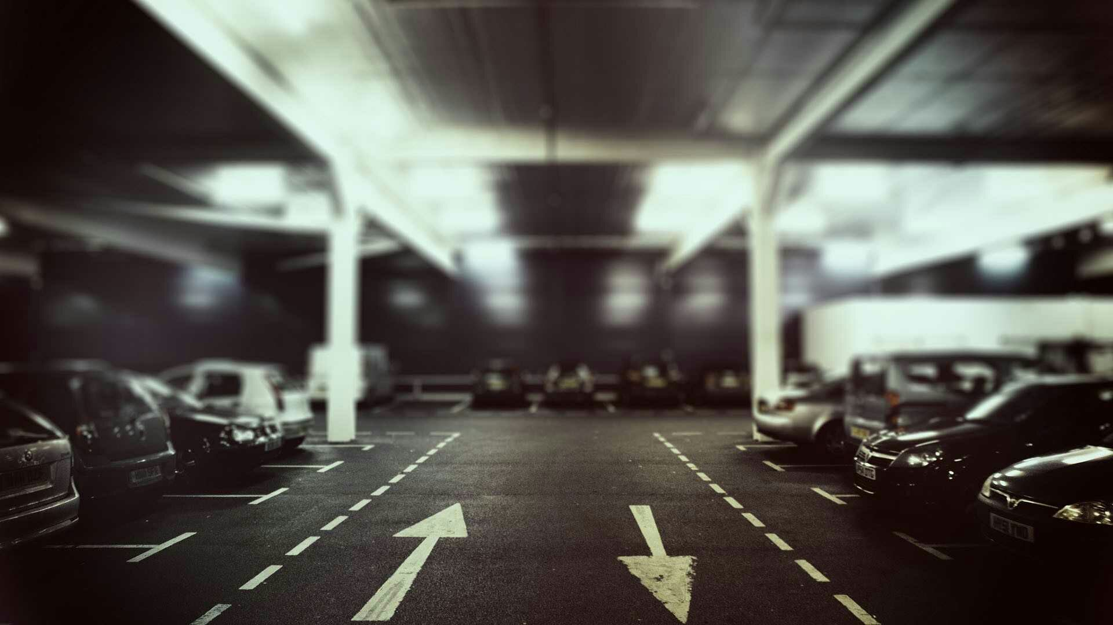
PARKIN
PARKING SOLUTION
Innovation meets technology
Notes:
To use this title animation slide with a new image simply 1) move the top semi-transparent shape to the side, 2) delete placeholder image, 3) click on the picture icon to add a new picture, 4) Move semi-transparent shape back to original position, 5) Update text on slide.

Slide 2
P R O J E C T G U I D E
Prof. Dr. Sheeja M K
HEAD OF DEPARTMENT, DEPARTMENT OF
ELECTRONICS AND COMMUNICATION ENGINEERING
“One person with PASSION is better than forty people merely interested.”
P R O J E C T B Y
Sujith S
ROLL NUMBER: 652
STUDENT, DEPARTMENT OF
ELECTRONICS AND COMMUNICATION ENGINEERING
—E.M. FORSTER

Slide 3
INTRODUCTION
TECHNOLOGIES
Contents
3
X
DESIGN FLOW
X
PROGRESS
SO FAR
CONCLUSION
Introduction (4)
Technology (5)
So far (12)
Design flow (9)
INTRODUCTION TO
THE PRODUCT
TECHNOLOGY BEHIND
THE PRODUCT
Conclusion (13)
Progress (11)

Slide 4

INTRODUCTION
INTRODUCTION
TECHNOLOGIES
Our mission
To help people easily find
Parking space without causing
Any time or money.
DESIGN FLOW
X
PROGRESS
SO FAR
CONCLUSION
Parkin is simply a platform that helps people find parking spots easily.
Why should we do this.
Number of parking lots are less in number and hence finding a perfect parking space nearer to the destination is hard, especially when it’s festival season

Slide 5
THE TECHNOLOGIES BEHIND PARKIN?
INTRODUCTION
TECHNOLOGIES
After detecting the space, User will be able to navigate to the destination using map and park their vehicle within the lot
5
DESIGN FLOW
X
X
PROGRESS
SO FAR
CONCLUSION
We use Artificial intelligence and machine learning to allocate parking lots in an efficient way, so that no space will be wasted.
Parkin uses CV, machine learning and artificial intelligence to Identify car parking space inside a city and users get the comfort of booking or knowing the available parking spaces nearer to their destination.
PARK IN
After the successful implementation, Parkin will provide the comfort of getting parking spots within 200 meter to the user’s destination. 3 years down the line.

Slide 6
PARKIN
INTRODUCTION
TECHNOLOGIES
PRODUCT
6
DESIGN FLOW
X
.
X
PROGRESS
SO FAR
CONCLUSION
The parking app and website
Demo

Slide 7
INTRODUCTION
TECHNOLOGIES
5 MOST IMPORTANT SERVICES
7
DESIGN FLOW
X
X
X
PROGRESS
SO FAR
CONCLUSION
1
2
3
4
5
Anyone can be a primary customer
Local area networking provides us a pool of opportunities
Services including Car wash, Internet, etc.. Can be added easily.
Parking space booking through internet
Using our AI algorithm, we find the best place for you and your vehicle

Slide 8
THE KEY TO SUCCESS IS | SPEED.
INTRODUCTION
TECHNOLOGIES
STEPS
8
DESIGN FLOW
X
PROGRESS
SO FAR
CONCLUSION
DESIGN FLOW

Slide 9
Meet Our Design Process
INTRODUCTION
TECHNOLOGIES
9
DESIGN FLOW
X
X
A look at our lifecycle flow
PROGRESS
SO FAR
CONCLUSION
Mapping
Obtain the map of a parking lot and mark the parking spaces in it
Ideate
We have already conducted some surveys which reveled that Trivandrum city has only one paid parking service and it is generating income at a high speed.

Slide 10
INTRODUCTION
TECHNOLOGIES
10
DESIGN FLOW
X
X
Computer vision
PROGRESS
Using computer vision, find the empty spots. Using the available map, obtain the location of free space. Upload the details to the website
SO FAR
CONCLUSION
Build
Building the MVP is the next step and is under construction. The minimum viable product will be a market ready prototype and after the customer response, we will add more features.

Slide 11
INTRODUCTION
TECHNOLOGIES
11
DESIGN FLOW
X
X
PROGRESS
SO FAR
CONCLUSION
Solution
The final product will be ready within 4 months time and will be able to perform all the above mentioned processes. This will be a solution to many problems

Slide 12
SO FAR
INTRODUCTION
TECHNOLOGIES
12
DESIGN FLOW
X
Created a detector that can
Identify Cars and other objects
Using some existing datasets
PROGRESS
SO FAR
CONCLUSION
GOT A FUNDING OF Rs. 2 LAKHS FROM KERALA STARTUP MISSION
Used raspberry pi 3 to implement the detection part
APPLIED MACHINE LEARNING TO THE COMPUTER VISION SYSTEM
Filing a patent for some
Advanced developments

Slide 13
CONCLUSION
INTRODUCTION
TECHNOLOGIES
13
13
DESIGN FLOW
X
PROGRESS
SO FAR
CONCLUSION
Within the next 4-5 months project will be completed
The project focuses on the existing parking problems inside the city
The technology behind the product can be used for many other applications also

Slide 14
MAPPING OF PARKING SPACE
LABELING
DESIGN
14
REQUIREMENTS
CLASSIFICATION
PARK.IN
UPDATE
LEARN
1
2
3
4
5
6
7
8
9
10
11
12
13
14
15
16
17
18

Slide 15



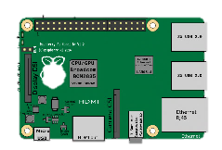


INTRODUCTION
TECHNOLOGIES
EXPLAINED
Using supervised learning, Teach the model to differentiate car from parking space
Detect whether the parking lot is empty or not by using the trained model
15
Get Video log from the parking lot
DESIGN FLOW
PROGRESS
SO FAR
CONCLUSION

Slide 16

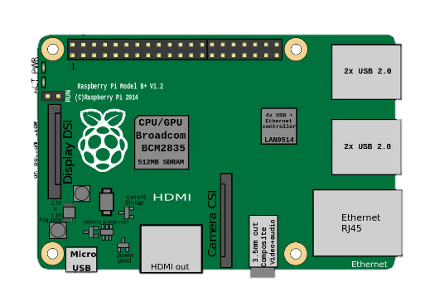




INTRODUCTION
TECHNOLOGIES
Software and Hardware parts
16
DESIGN FLOW
PROGRESS
SO FAR
CONCLUSION

Slide 17
17
Classification of vacancies
Capture
Segmentation / Simplification
Extraction of Characteristics
Classification
Merger and Result
Capture
Image of the vacancies
FLOW CHART
Segmentation of the picture in individual vacancies
preparation
CNN
Vector of Characteristics 1
Set of specialist classifiers
Classification
Combination
Vector of Characteristics 2
Set of specialist classifiers
Status of vacancies
Set of specialist classifiers
Vector of Characteristics n

Slide 18

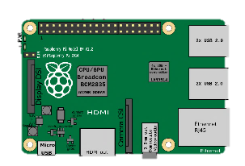

Raspberry pi
GPIO
USB Port×4
HDMI PORT
ETHERNET PORT

Slide 19
INTRODUCTION
TECHNOLOGIES
18
DESIGN FLOW
X
X
PROGRESS
SO FAR
CONCLUSION
THE WORLD
IS CHANGING VERY FAST.
THE BIG WILL NOT BEAT THE SMALL ANYMORE.
IT WILL BE
THE FAST BEATING THE SLOW.
—RUPERT MURDOCH

Slide 20
Thank You..
INTRODUCTION
TECHNOLOGIES
20
DESIGN FLOW
X
X
PROGRESS
SO FAR
CONCLUSION
Questions?

